Slide 1
Schedule SAS Tasks

Slide 2
Create a .txt file
The following syntax will run a SAS program
"dir/sas.exe" -SYSIN "dir/file.sas" -LOG "dir/file.log" -PRINT "dir/file.lst“

Slide 3
dir/sas.exe
dir/sas.exe is the location of sas on your computer
For BECCA it’s
"C:\Program Files\SASHome\SASFoundation\9.4\sas.exe“
Please note when we upgrade to 9.5 then this path will become
"C:\Program Files\SASHome\SASFoundation\9.5\sas.exe“

Slide 4
-SYSIN "dir/file.sas"
-SYSIN will run a sas program
Replace dir/file.sas with your sas file

Slide 5
-LOG "dir/file.log"
-LOG will save the sas program’s log
Replace dir/file.log with an appropriate location to save the log

Slide 6
-PRINT "dir/file.lst“
-PRINT will save the output of the results viewer
The file can be opened in SAS
Replace dir/file.lst with an appropriate location and file name

Slide 7

Rename the .txt file as .bat
1
2

Slide 8
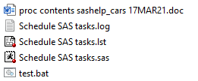
Test the .bat file by double clicking it
Check the log and all output

Slide 9
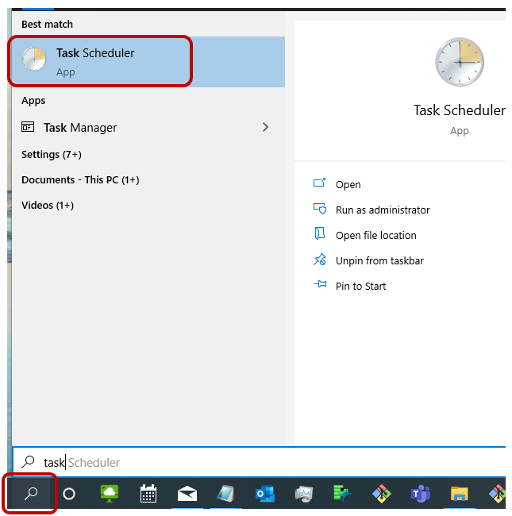
Schedule the .bat file to run periodically
Windows 10
Open Task Scheduler

Slide 10
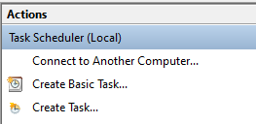
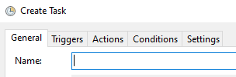
Create Task
Select Create Task
Name the task

Slide 11


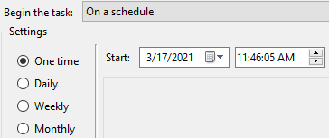

Triggers
Select Triggers
Select New
Select the appropriate recurrence and start time followed by OK

Slide 12
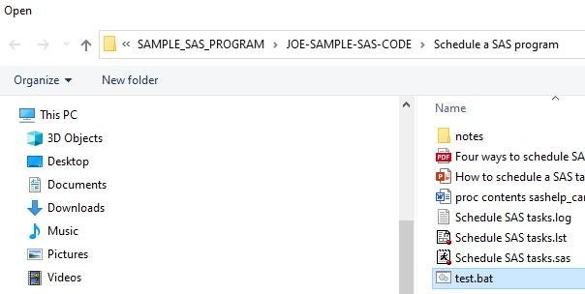
Actions
Select Actions
Select New
Select Browse followed the path for the .bat file and OK

Slide 13
General
Select General
Select OK to finalize the task schedule
The SAS program will now run automatically

Slide 14
Source
https://blogs.sas.com/content/sgf/2013/08/14/four-ways-to-schedule-sas-tasks/
Accessed 3/17/2021

